Slide 1
Building Cloud-Native Applications using Pivotal Cloud Foundry
By Dominic Tippabattuni

Slide 2
Agenda
What is Cloud-Native?
Cloud-Native vs Traditional Application
Pivotal Cloud Foundry - PaaS
Demo PCF usage
Questions

Slide 3
What is Cloud-Native?
“An approach to build and run applications that fully exploit the advantages of the cloud computing delivery model”.
“Its about how applications are created and deployed, not where”. - Pivotal Cloud Foundry

Slide 4
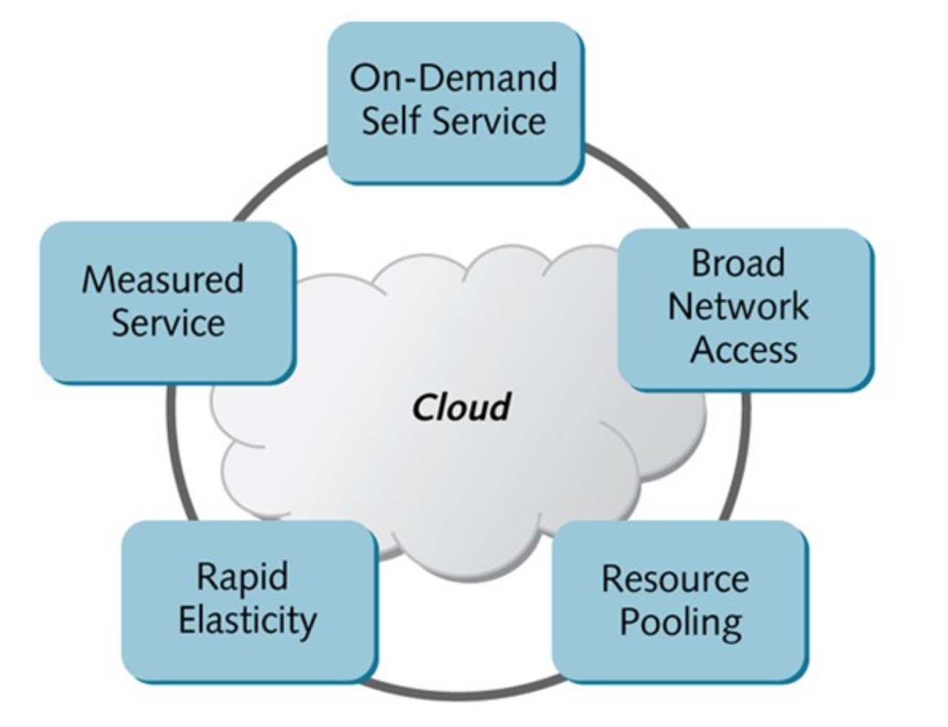
Cloud Computing Types & Characteristics
Public
Private
Hybrid
Community

Slide 5
Cloud Computing Types & Characteristics
Pay-As-You-Go!

Slide 6

Cloud-Native Application Properties
Container – packaged
Dynamically managed
Micro-services oriented

Slide 7
Cloud-Native vs Traditional Application
Cloud-Native Application | Traditional Application
Predictable | Unpredictable
OS Abstraction | OS Dependent
Independent | Over-sized Capacity
Collaborative | Siloed
Automated Scaling | Manual Scaling
Continuous Delivery | Waterfall Development

Slide 8
Cloud-Native vs Traditional Application
Cloud-Native Application | Traditional Application
Predictable 12-Factor | Unpredictable
OS Abstraction | OS Dependent
Independent | Dependent
Collaborative | Siloed
Automated Scaling | Manual Scaling
Continuous Delivery | Waterfall Development

Slide 9
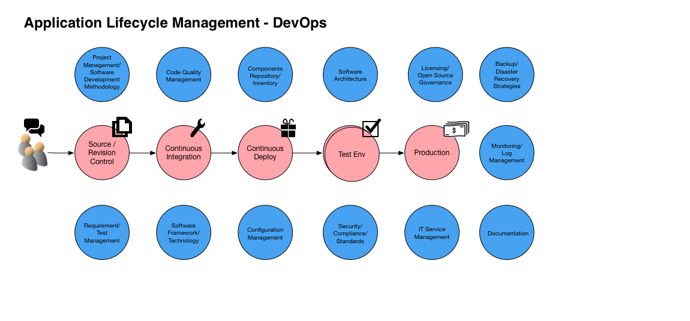
Predictable vs Unpredictable Apps

Slide 10
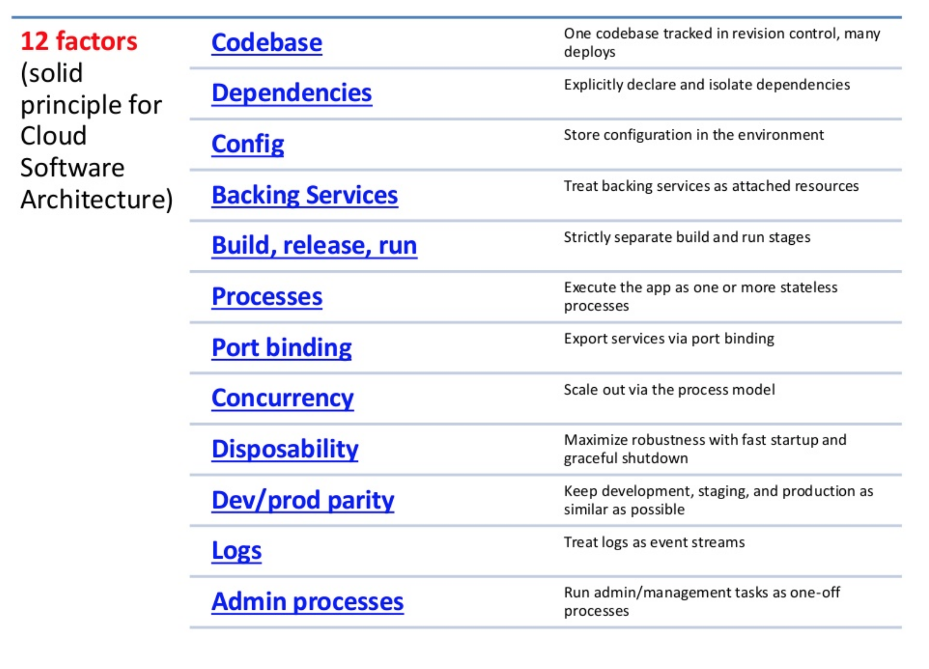
Predictable vs Unpredictable Apps

Slide 11
Cloud-Native vs Traditional Application
Cloud-Native Application | Traditional Application
Predictable | Unpredictable
OS Abstraction Container | OS Dependent
Independent | Dependent
Collaborative | Siloed
Automated Scaling | Manual Scaling
Continuous Delivery | Waterfall Development
Notes:
Cloud-Native use platform to abstract underlying OS. Traditional applications rely on underlying OS resources, hardware, resources and backing services.

Slide 12
OS Abstraction vs OS Dependent

Slide 13
Cloud-Native vs Traditional Application
Cloud-Native Application | Traditional Application
Predictable | Unpredictable
OS Abstraction | OS Dependent
Independent Microservices | Dependent
Collaborative | Siloed
Automated Scaling | Manual Scaling
Continuous Delivery | Waterfall Development
Notes:
Using Microservices we can build loosely coupled services with well defined boundaries.

Slide 14
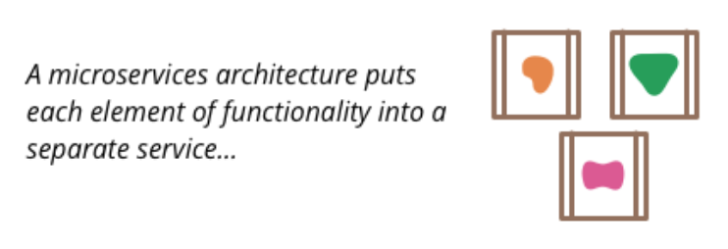
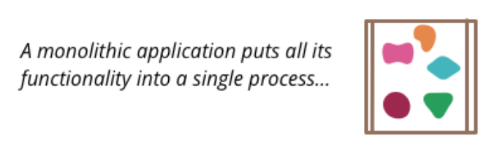
Independent vs Dependent
Notes:
Using Microservices we can build loosely coupled services with well defined boundaries.

Slide 15
Cloud-Native vs Traditional Application
Cloud-Native Application | Traditional Application
Predictable | Unpredictable
OS Abstraction | OS Dependent
Independent | Dependent
Collaborative DevOps | Siloed
Automated Scaling | Manual Scaling
Continuous Delivery | Waterfall Development
Notes:
DevOps culture enables more collaboration. Siloed or “over the wall”

Slide 16
Cloud-Native vs Traditional Application
Cloud-Native Application | Traditional Application
Predictable | Unpredictable
OS Abstraction | OS Dependent
Independent | Over-sized Capacity
Collaborative | Siloed
Automated Scaling | Manual Scaling
Continuous Delivery | Waterfall Development

Slide 17
Cloud-Native vs Traditional Application
Cloud-Native Application | Traditional Application
Predictable | Unpredictable
OS Abstraction | OS Dependent
Independent | Over-sized Capacity
Collaborative | Siloed
Automated Scaling | Manual Scaling
Continuous Delivery | Waterfall Development
Notes:
Container based vs VM based

Slide 18
OKAY, BUT HOW ???
Cloud-Native Application
Predictable
OS Abstraction
Independent
Collaborative
Automated Scaling
Continuous Delivery

Slide 19
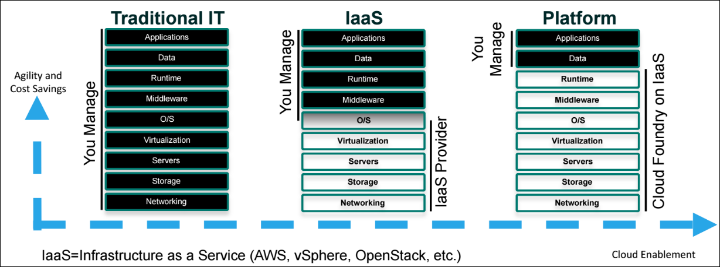
Using a Platform …

Slide 20
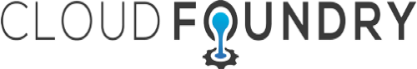
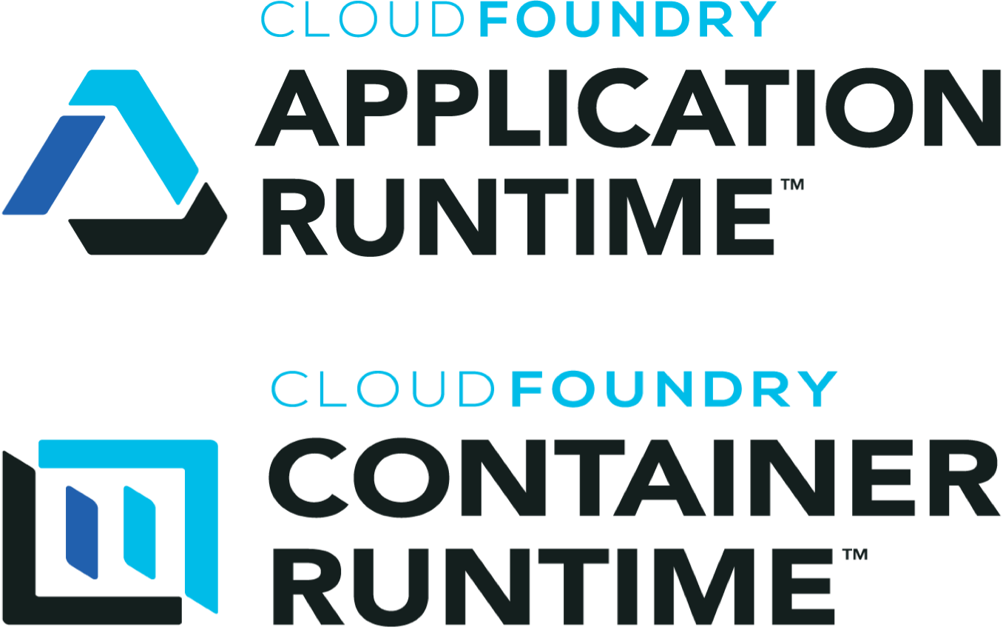
Cloud Foundry – Platform-as-a-Service
Industry standard cloud platform
Open Source Project (Ruby, Go, Java)
Supported by Cloud Foundry Foundation
Home for CF Application Runtime and CF Container Runtime

Slide 21
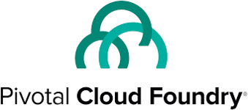
Pivotal Cloud Foundry - PaaS
Cloud Foundry certified provider
Facilitates building applications based on 12-Factor methodology
“Transform how the world builds software”

Slide 22
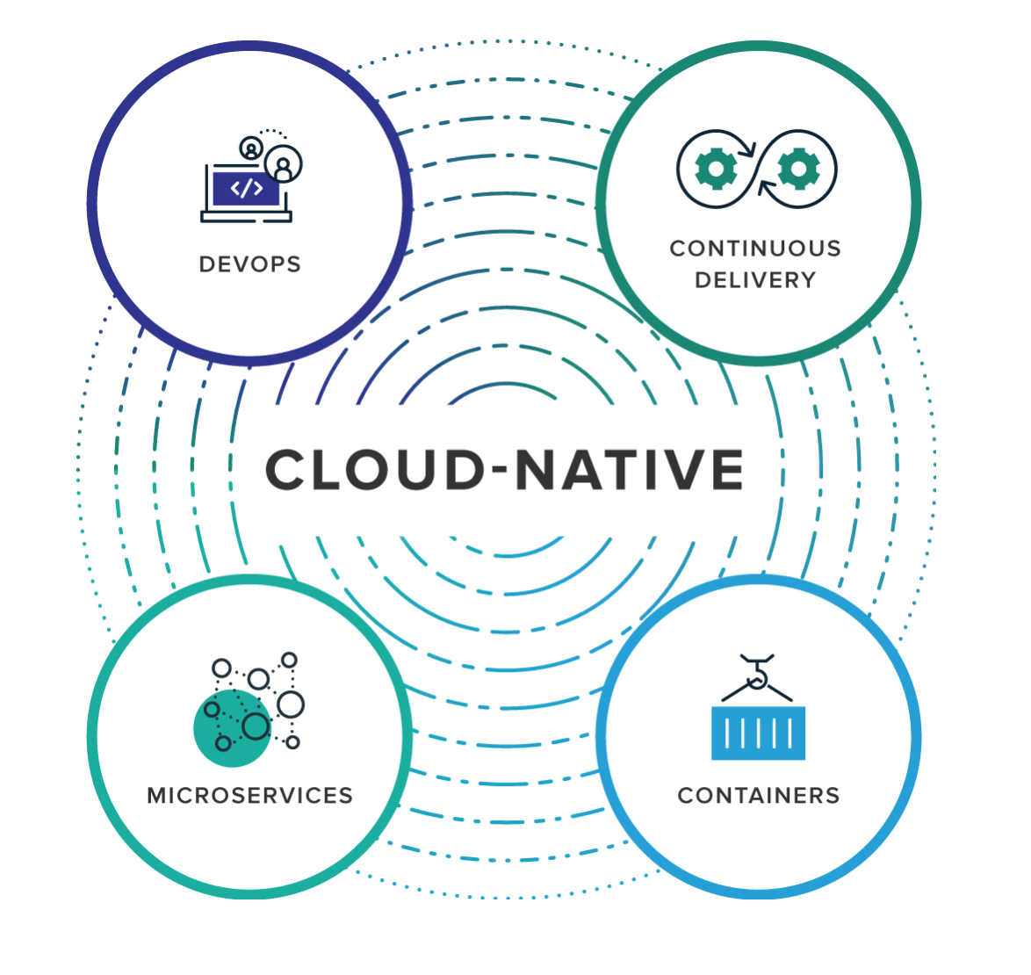
Pivotal Cloud Foundry – Core Tenets
Self-serve platform for developers.
Operationally Robust
IaaS Independent

Slide 23
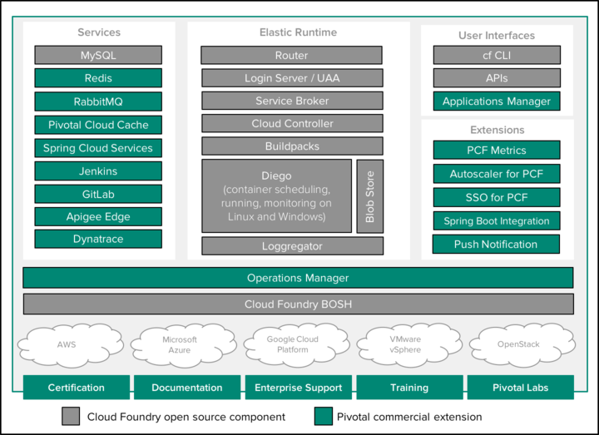
Pivotal Cloud Foundry - PaaS

Slide 24
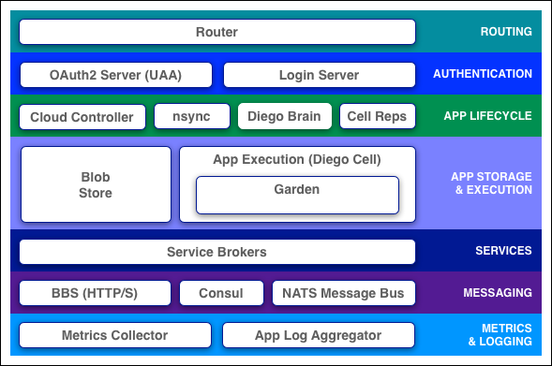
Component: Elastic Runtime

Slide 25
Component: Cloud-Controller
Provides REST endpoint for clients to access the system.
Maintains the database for org, spaces, services, user roles and more.
Interacts with
Diego Auction
Database (CC_DB)
Blobstore

Slide 26
Component: BOSH / Operations Manager
Handles entire lifecycle required to run Cloud Foundry
bosh deploy (operator) “here are my servers go make them a cloud foundry i do not care how”

Slide 27
Component: Buildpacks
Builds the Droplet.
Scripts
bin/detect
bin/supply
bin/finalize
bin/release
bin/compile
Sample Buildpacks
Binary
Go
Java
.NET Core,
Node.js
PHP
Python
Ruby
StaticFile

Slide 28

Demo: User Interfaces
PCF Applications Manager
CF CLI
https://console.run.pivotal.io/

Slide 29
PCF - Applications Manager - Basics
Org
Spaces
Domains
Routes

Slide 30
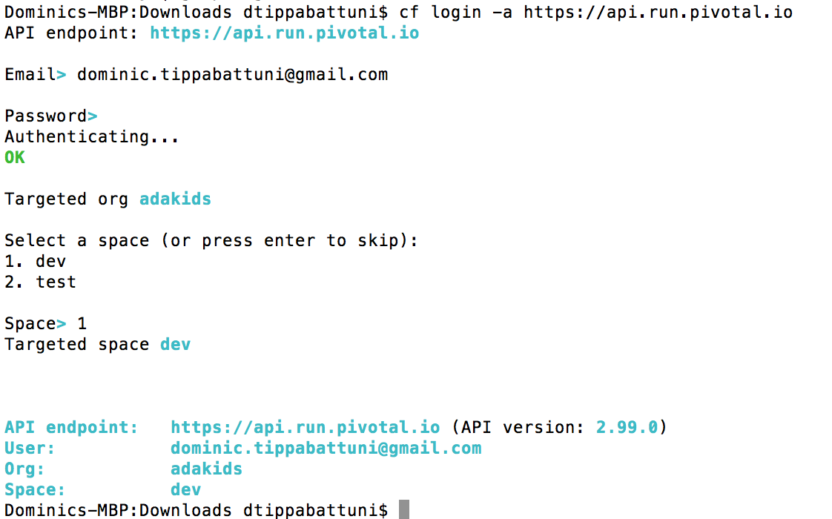
cf login - log user in to a target PCF instance

Slide 31
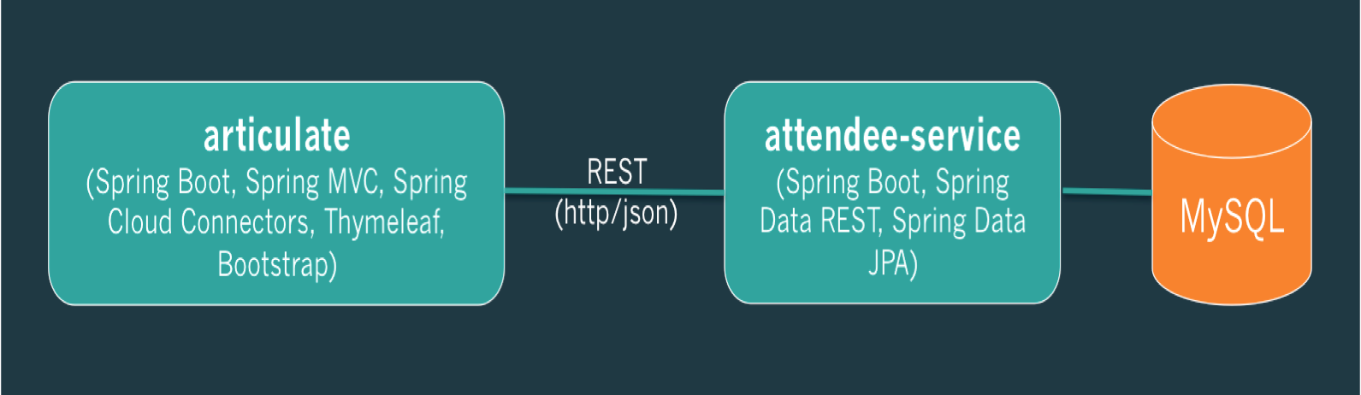
Demo: Ref App Deployment

Slide 32
Step 1: Create DB Service
Service Name: attendee-mysql

Slide 33
Step 2: Deploy attendee-service – cf push
“here is my source code run it on the cloud for me i do not care how”

Slide 34
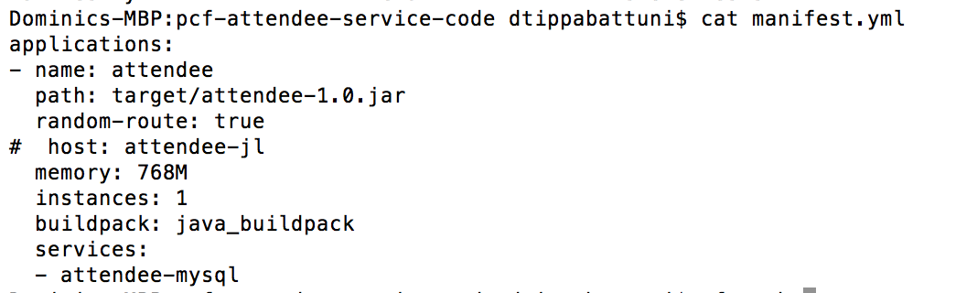
manifest.yml
Provides consistency and reproducibility
Helps automate deploying apps
https://github.com/dtippabattuni/pcf-demo/blob/master/cf-push

Slide 35
cf push – overview

Slide 36
cf push – Staging Sequence

Slide 37
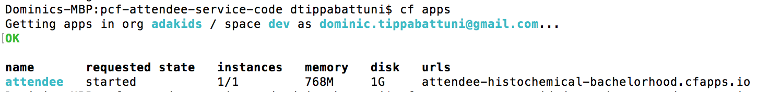
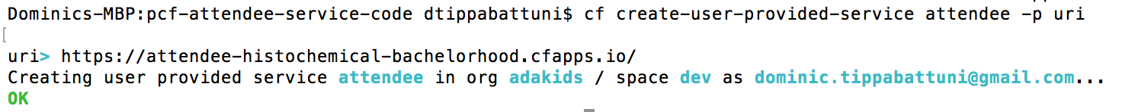
Step 3: cf create-user-provided-service
cf apps
cf create-user-provided-service, cups

Slide 38
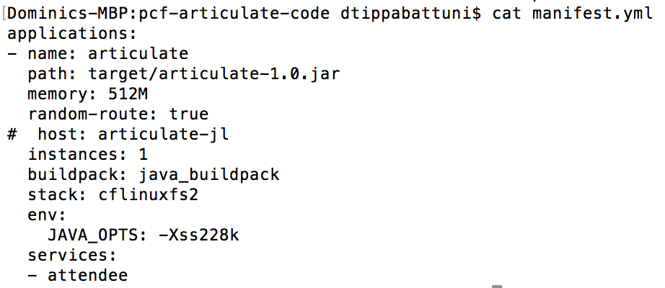
Step 4: Deploy articulate app – cf push

Slide 39
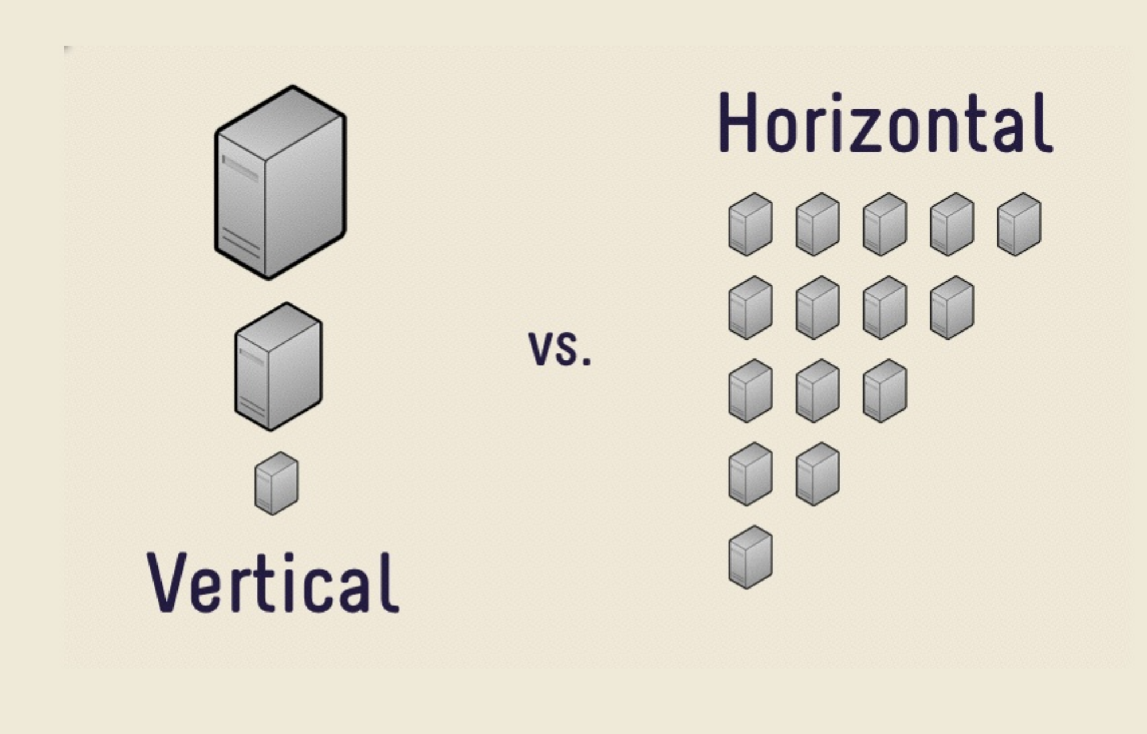
Demo: Scaling – cf scale

Slide 40
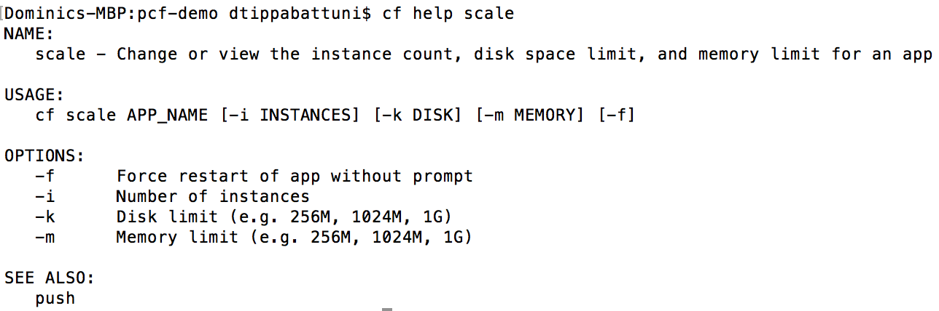
Demo: Scaling – cf scale

Slide 41
Questions??

Slide 42
References
https://content.pivotal.io/blog/pivotal-cloud-foundry-s-roadmap-for-2016
https://pivotal.io/cloud-native
http://docs.cloudfoundry.org/
https://app.pluralsight.com/library/courses/cloud-foundry-developers/table-of-contents

